Slide 1


Produced by: Renzo Macedo
Date: September 2022

Slide 2

Outline
Executive Summary
Introduction
Methodology
Results
Conclusion
Appendix

Slide 3
Executive Summary
Summary of methodologies
Data Collection with Web Scraping
Data Collection through API
Data Wrangling
Exploratory Data Analysis with SQL
Exploratory Data Analysis with Data Visualization
Building a Dashboard with Ploty Dash
Interactive Visual Analytics with Folium
Machine Learning Prediction
Summary of all results
Exploratory Data Analysis result
Interactive analytics in screenshots
Predictive Analytics result

Slide 4
Introduction
Project background and context
SpaceX advertises Falcon 9 rocket launches on its website with a cost of 62 million dollars; other providers cost upward of 165 million dollars each, much of the savings is because SpaceX can reuse the first stage.
Problems you want to find answers
If we can determine if the first stage will land successfully, we can determine the cost of a launch

Slide 5

Section 1

Slide 6
Methodology
Executive Summary
Data collection methodology:
Web scraping: Extract a Falcon 9 launch records HTML table from Wikipedia
Data collection API: Request to the SpaceX API
Perform data wrangling
Perform exploratory Data Analysis and determine Training Labels, Cleaning data of null values and irrelevant columns
Perform exploratory data analysis (EDA) using visualization and SQL
Perform interactive visual analytics using Folium and Plotly Dash
Perform predictive analysis using classification models
Create column class(succeed or fail) ,Standardize the data, split into training and test data, Find best Hyperparameter for SVM, Classification Trees and Logistic Regression and evaluate accuracy and tunes hyperparameters with GridSearchCV object

Slide 7
Data Collection
Extract a Falcon 9 launch records HTML table from Wikipedia and parse the table and convert it into a Pandas data frame with BeautifulSoup
Data collection API: Request to the SpaceX API using Pandas and Numpy and use json to decode the response content and turn it into Pandas dataframe
Wikipedia
BeautifulSoup
Normalize data into csv file
Data ready for wrangling
SpaceX API
Json
Normalize data into csv file

Slide 8
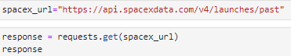
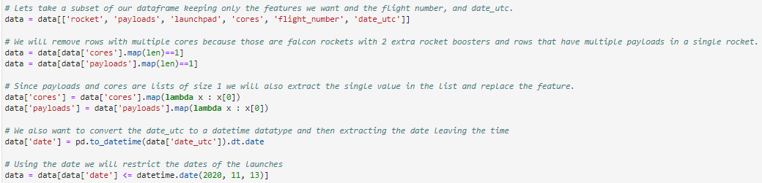
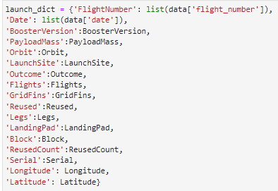
Data Collection – SpaceX API
Data collection with SpaceX REST calls
https://github.com/renzomacedo/DataScienceCapstone/blob/main/jupyter-labs-spacex-data-collection-api.ipynb
1º Get the data from SpaceX Rest
2º Convert the json result into a data frame
3º Clean Data and take subset of our dataframe
4ºConstruct our dataset and combine into a dictionary
5º Export to csv file

Slide 9
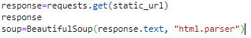
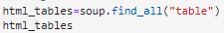
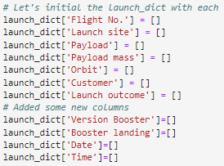
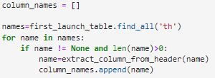
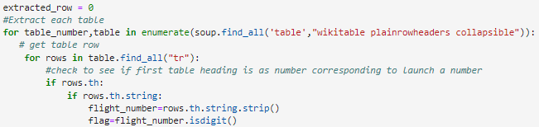
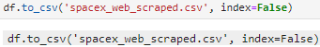
Data Collection - Scraping
1º Getting response from html web and create coup object
2º Finding tables
3º Getting columns
4º Create a dictionary
5º Appending data to dictionary keys
6º Dictionary to dataframe and dataframe to csv
Web scraping: Extract a Falcon 9 launch records HTML table from Wikipedia
https://github.com/renzomacedo/DataScienceCapstone/blob/main/jupyter-labs-webscraping.ipynb

Slide 10
Data Wrangling
https://github.com/renzomacedo/DataScienceCapstone/blob/main/labs-jupyter-spacex-Data%20wrangling.ipynb
Calculate number of launch on each site
Calculate the number and occurrence of each orbit
Calculate the number and occurrence of mission outcome per orbit type
Create a landing outcome label from Outcome column
Calculate the success rate
Check null values

Slide 11
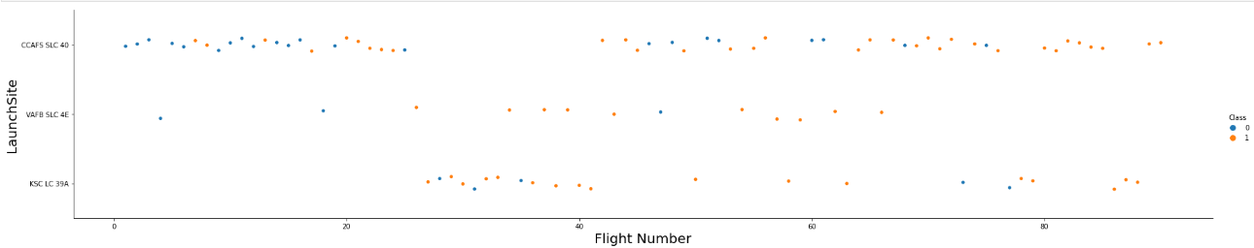
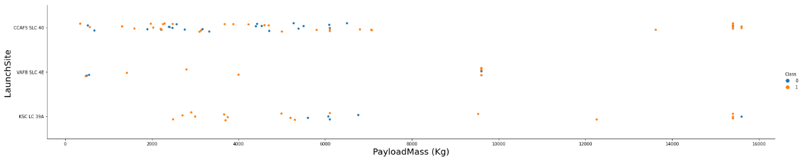
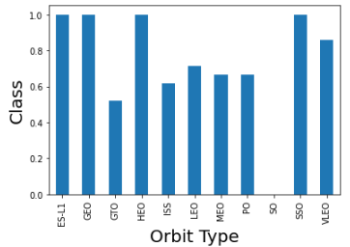
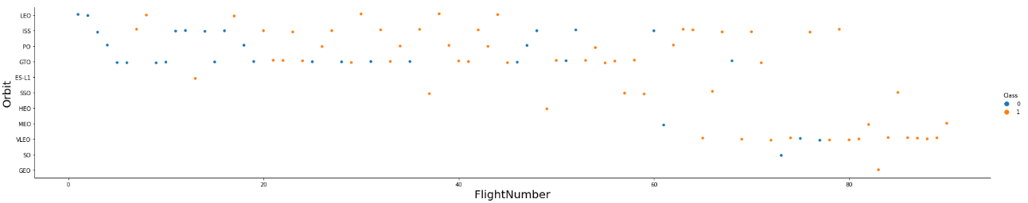
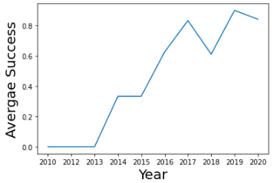
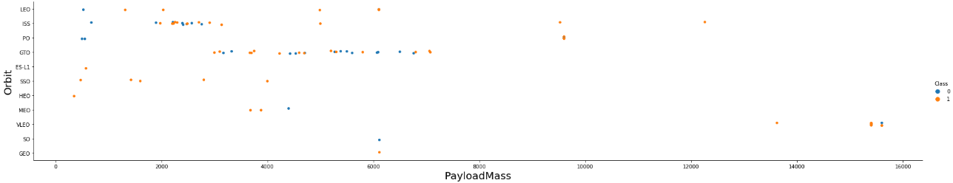
EDA with Data Visualization
https://github.com/renzomacedo/DataScienceCapstone/blob/main/jupyter-labs-eda-dataviz.ipynb

Slide 12
EDA with SQL
SQL queries performed
The names of unique launch sites in the space mission.
The total payload mass carried by boosters launched by NASA (CRS)
The average payload mass carried by booster version F9 v1.1
The total number of successful and failure mission outcomes
The failed landing outcomes in drone ship, their booster version and launch site names.
https://github.com/renzomacedo/DataScienceCapstone/blob/main/jupyter-labs-eda-sql-coursera_sqllite.ipynb

Slide 13
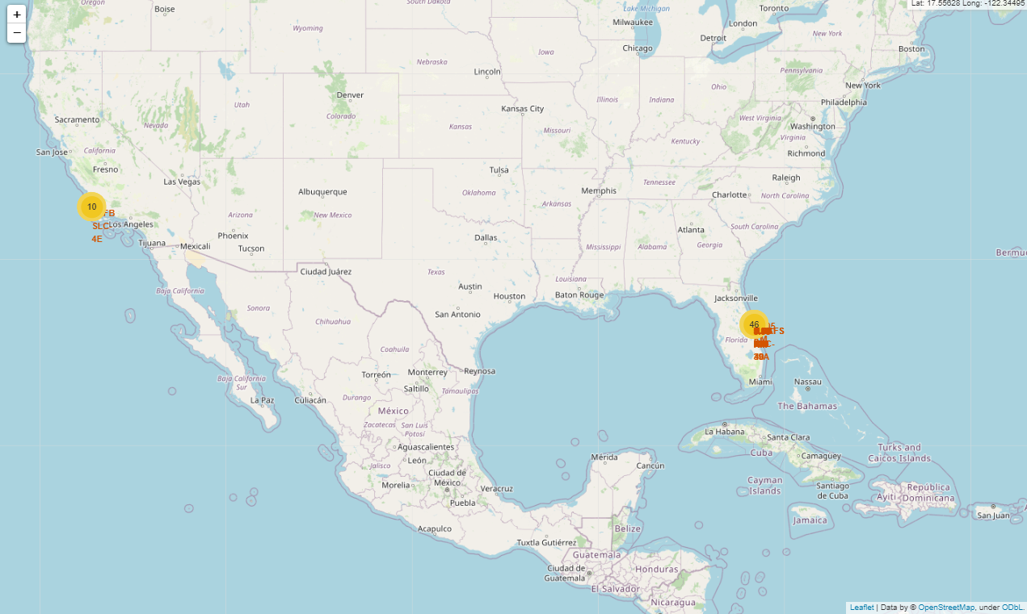
Build an Interactive Map with Folium
We marked all launch sites, and added map objects such as markers, circles, lines to mark the success or failure of launches for each site on the folium map.
We assigned the feature launch outcomes (failure or success) to class 0 and 1.i.e., 0 for failure, and 1 for success.
Using the color-labeled marker clusters, we identified which launch sites have relatively high success rate.
We calculated the distances between a launch site to its proximities. We answered some question for instance:
Are launch sites near railways, highways and coastlines.
Do launch sites keep certain distance away from cities.
https://github.com/renzomacedo/DataScienceCapstone/blob/main/lab_jupyter_launch_site_location.ipynb

Slide 14
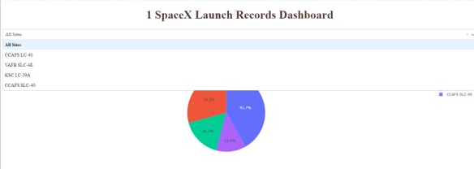
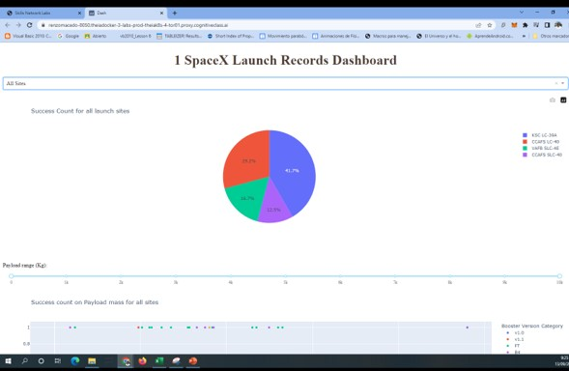
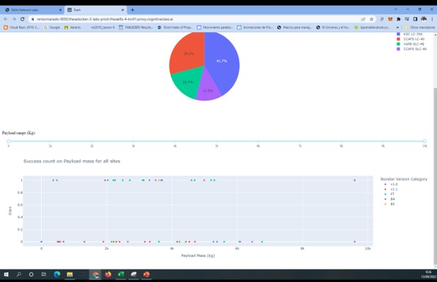
Build a Dashboard with Plotly Dash
Built an interactive dashboard with Plotly dash
Plotted pie charts showing the total launches by a certain sites
Plotted scatter graph showing the relationship with Outcome and Payload Mass (Kg) for the different booster version.
https://github.com/renzomacedo/DataScienceCapstone/blob/main/spacex_dash_app.py

Slide 15
Predictive Analysis (Classification)
We loaded the data using numpy and pandas, transformed the data, split our data into training and testing.
We built different machine learning models and tune different hyperparameters using GridSearchCV.
We used accuracy as the metric for our model, improved the model using feature engineering and algorithm tuning.
We found the best performing classification model.
https://github.com/renzomacedo/DataScienceCapstone/blob/main/SpaceX_Machine%20Learning%20Prediction_Part_5.ipynb

Slide 16
Results
The Logistic Regression, SVM and KNN models are the best in prediction accuracy
Low weighted payloads perform better than heavier payloads
The success rate of SpaceX launches is directly proportional to the time in years due to the refinement of the launches.
The launcher place KSC LC 39A had the most successful launches site

Slide 17

Section 2

Slide 18
Flight Number vs. Launch Site
Launches from CCAFS scl 40 are higher than launches form other sites

Slide 19
Payload vs. Launch Site
Higher the payload mass for the CCAFS SLC 40 launch site, the higher the success rate of the rocket

Slide 20
Success Rate vs. Orbit Type
From the plot, we can see that ES-L1, GEO, HEO, SSO, VLEO had the most success rate.

Slide 21
Flight Number vs. Orbit Type
We observe that in the LEO orbit, success is related to the number of flights

Slide 22
Payload vs. Orbit Type
There are strong correlation between ISS and Payload at the range around 2000, as well as between GTO and the range of 4000-8000

Slide 23
Launch Success Yearly Trend
Launch success rate has increased significantly since 2013 and stablised since 2019, due to advance in technologic

Slide 24
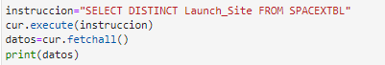
All Launch Site Names
We used the key word DISTINCT to show only unique launch sites from the SpaceX data.
[('CCAFS LC-40',), ('VAFB SLC-4E',), ('KSC LC-39A',), ('CCAFS SLC-40',)]

Slide 25
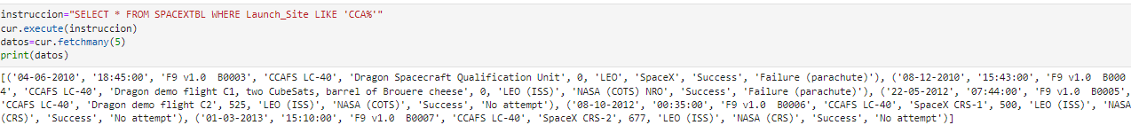
Launch Site Names Begin with 'CCA'
We used the query above to display 5 records where launch sites begin with `CCA`

Slide 26
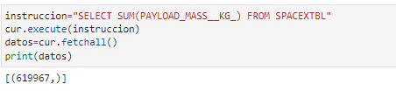
Total Payload Mass
We sum all column data about Payload mass

Slide 27
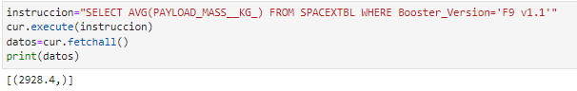
Average Payload Mass by F9 v1.1
Calculate the average payload mass carried by booster version F9 v1.1 where Booster version is F9 v1.1

Slide 28
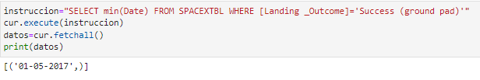
First Successful Ground Landing Date
We get the dates of the first successful landing outcome on ground pad :

Slide 29
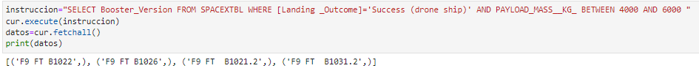
Successful Drone Ship Landing with Payload between 4000 and 6000
List the names of boosters which have successfully landed on drone ship and had payload mass greater than 4000 but less than 6000
We used the WHERE clause to filter for boosters which have successfully landed on drone ship and applied the AND condition to determine successful landing with payload mass greater than 4000 but less than 6000

Slide 30
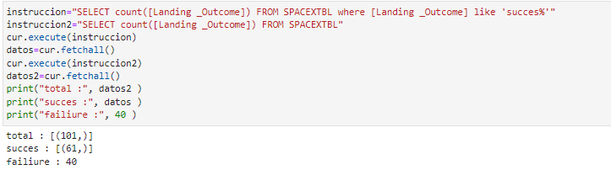
Total Number of Successful and Failure Mission Outcomes
Calculate the total number of successful and failure mission outcome

Slide 31
Boosters Carried Maximum Payload
List the names of the booster which have carried the maximum payload mass

Slide 32
2015 Launch Records
List the failed landing_outcomes in drone ship, their booster versions, and launch site names for in year 2015

Slide 33

Rank Landing Outcomes Between 2010-06-04 and 2017-03-20
Rank the count of landing outcomes (such as Failure (drone ship) or Success (ground pad)) between the date 2010-06-04 and 2017-03-20, in descending order

Slide 34

Section 3

Slide 35
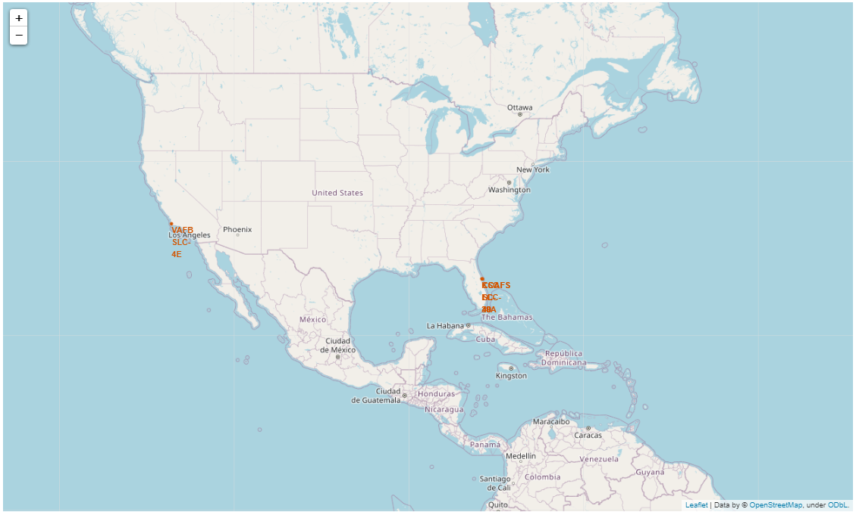
All launch sites global map markers
All launch site of SpaceX is located in United Stated coast, in Florida and California

Slide 36
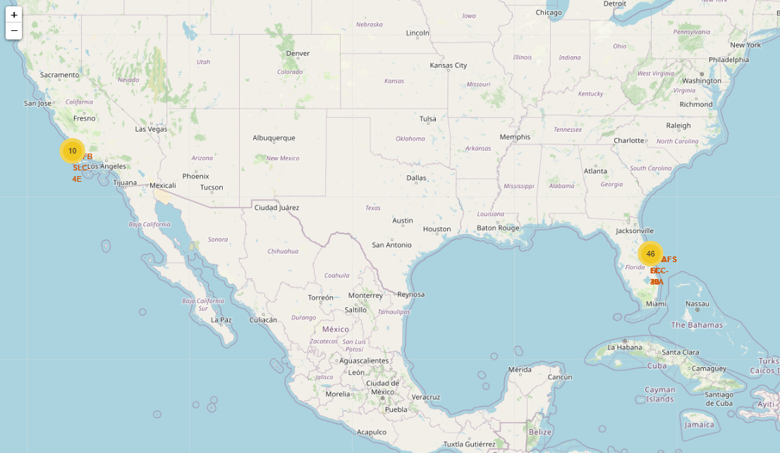
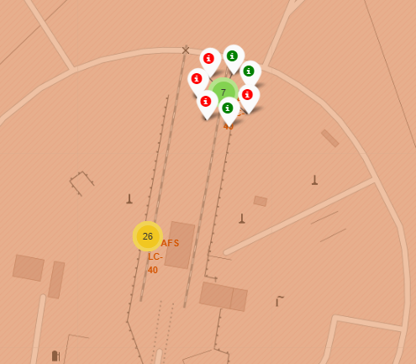
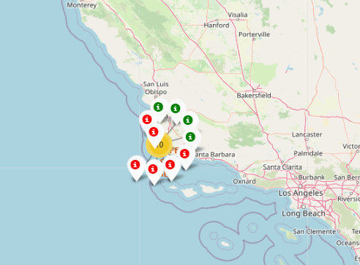
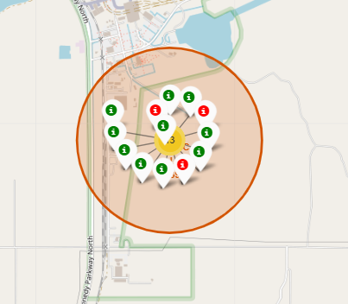
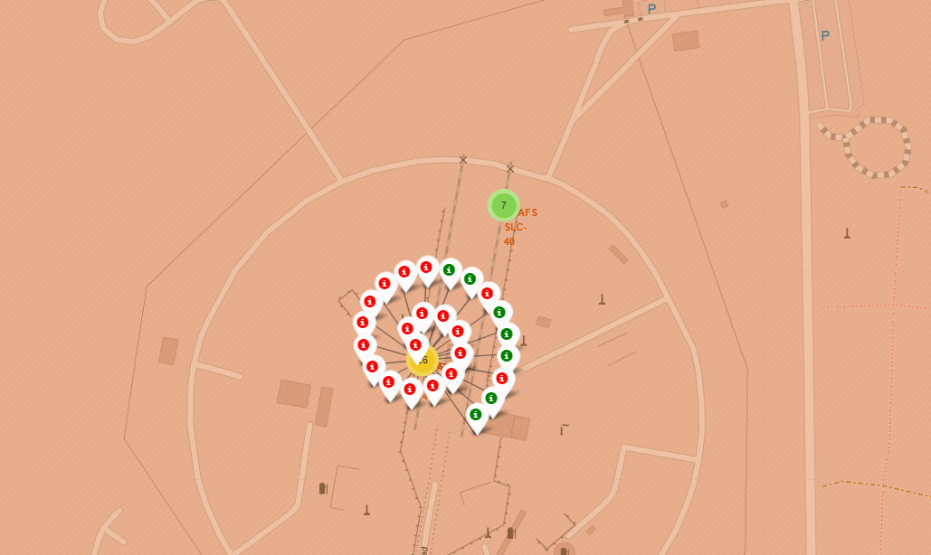
Success/failed launches for each site on the map
Green marker show successful launches and red mark show failiure

Slide 37
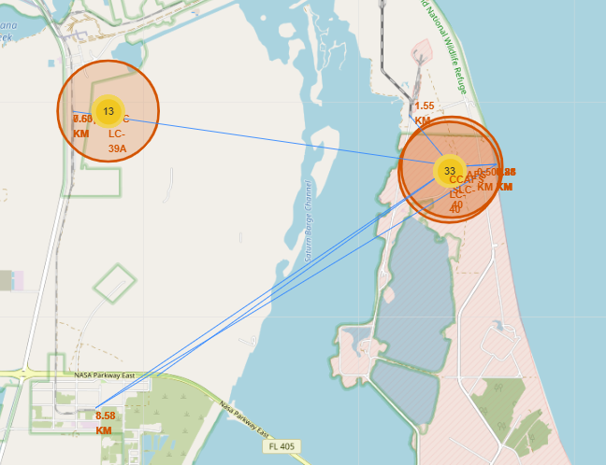
Distances between a launch site to its proximities
The lines show distances and kilometers to city, railways and coasts

Slide 38

Section 4

Slide 39

Total success launches by all sites

Slide 40
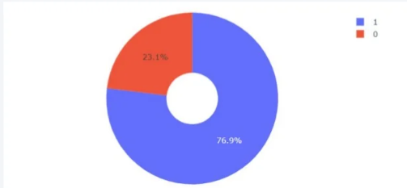
Success rate by site

Slide 41

Payload vs launch outcome for all sites
Success launches
Fail launches

Slide 42

Section 5

Slide 43
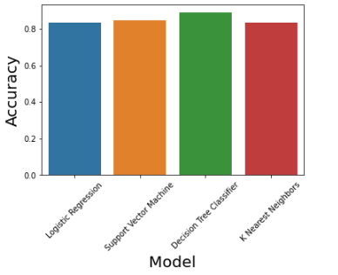
Classification Accuracy
All model are similar Accuracy
The decision tree classifier is the model with the highest classification accuracy

Slide 44
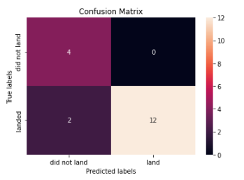
Confusion Matrix
The confusion matrix for the decision tree classifier shows that the classifier can distinguish between the different classes. The major problem is the false negative .i.e., unsuccessful landing marked as successful landing by the classifier.

Slide 45
Conclusions
The SVM, KNN, and Logistic Regression models are the best in terms of prediction accuracy for this dataset, being the most precise the decision tree classifier.
Low weighted payloads perform better than the heavier payloads.
The success rates for SpaceX launches is directly proportional time in years, because they will perfect the launches and the technology.
KSC LC 39A had the most successful launches from all the sites.
Orbit GEO,HEO,SSOES L1 has the best Success Rate.

Slide 46
Appendix
Include any relevant assets like Python code snippets, SQL queries, charts, Notebook outputs, or data sets that you may have created during this project

Slide 47


